Slide 1


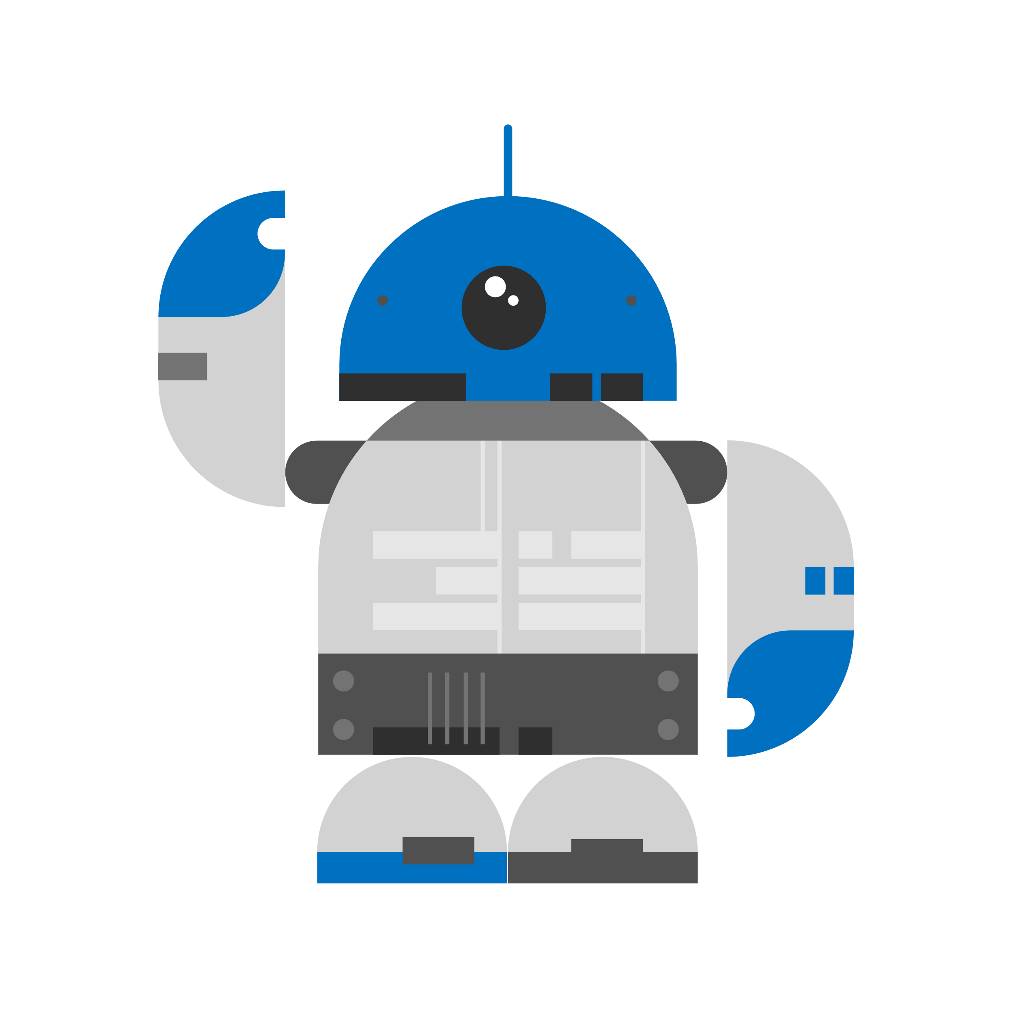




Space Event Deck
Engineering Cubes
Launch pad
Mission Control Cubes
Mission Cards
Emergency PR
Splash pad
Cubes
Research item deck
Media card deck
Space Event Discard
Research Cubes
Destination Space
Communication Cubes

Slide 2
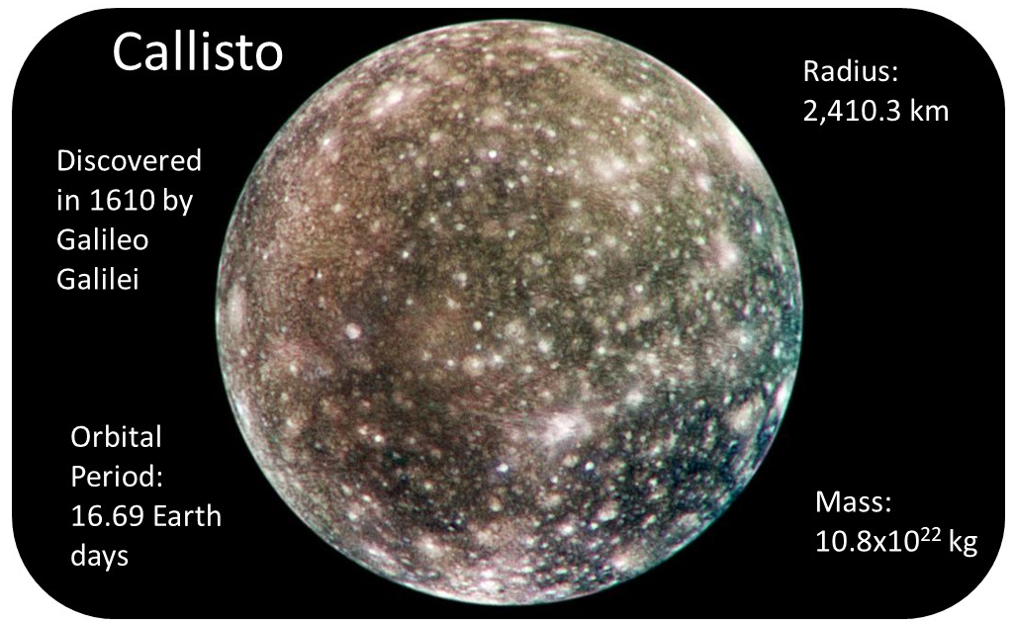
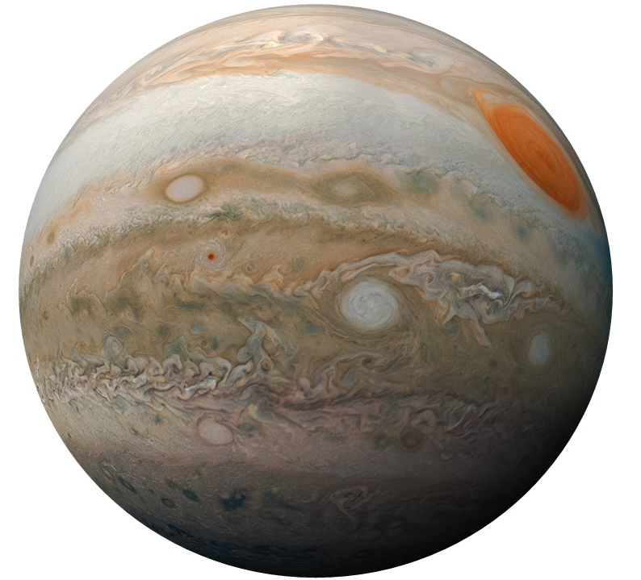
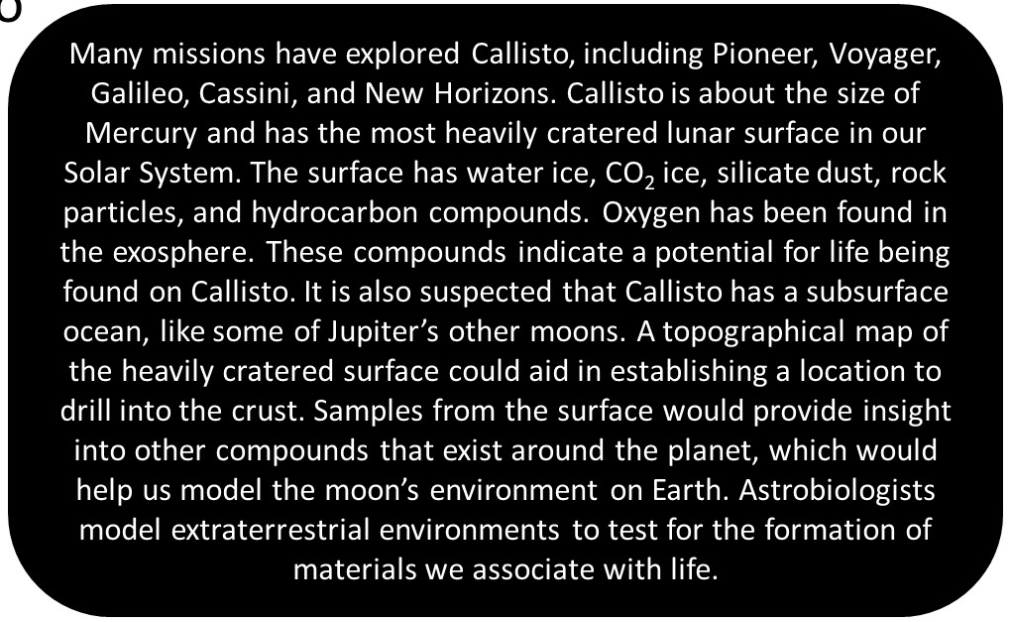
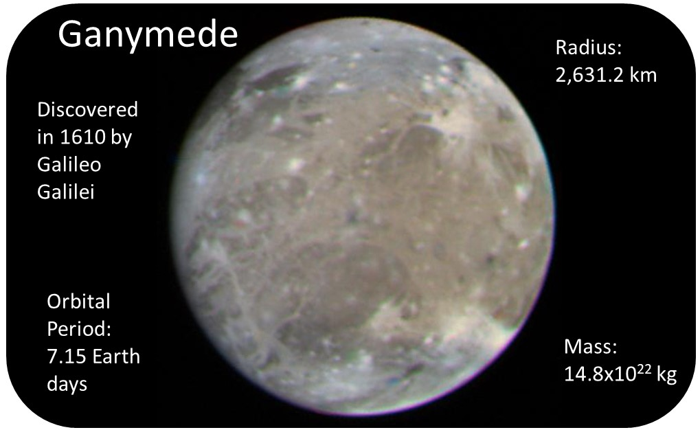
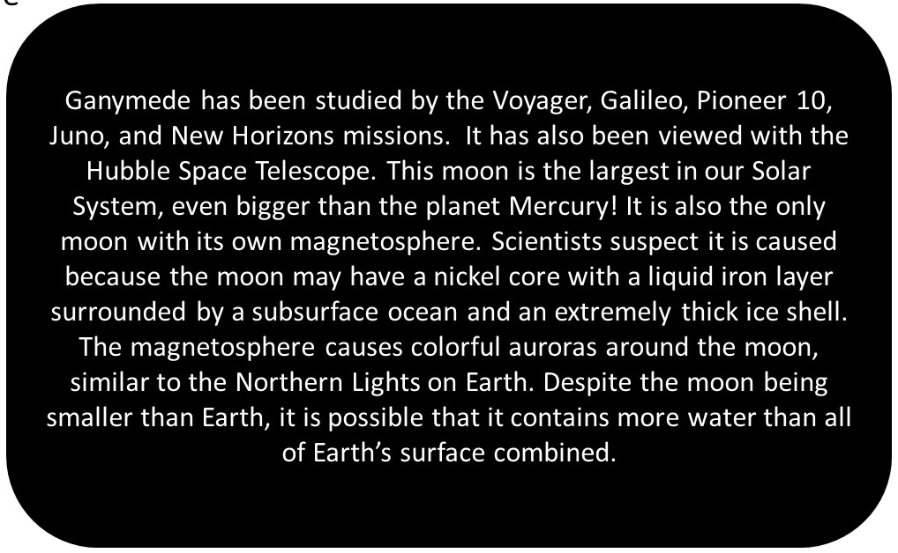
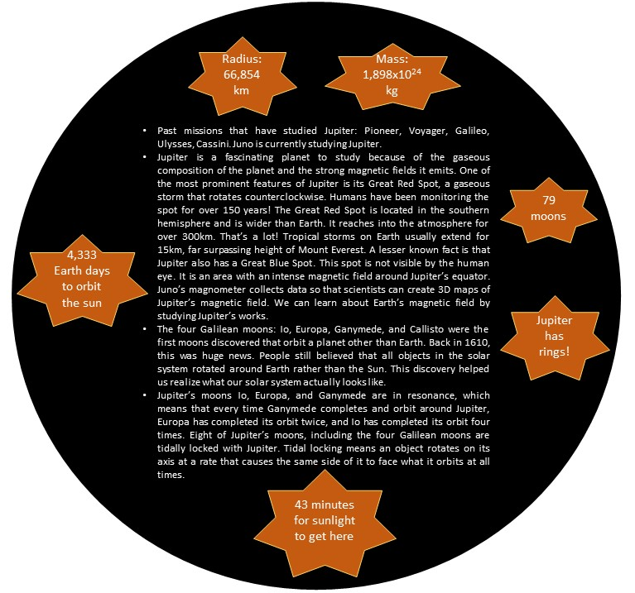
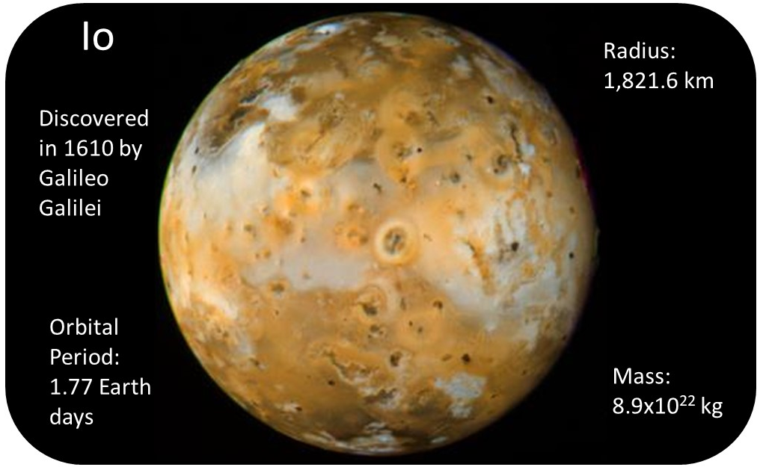
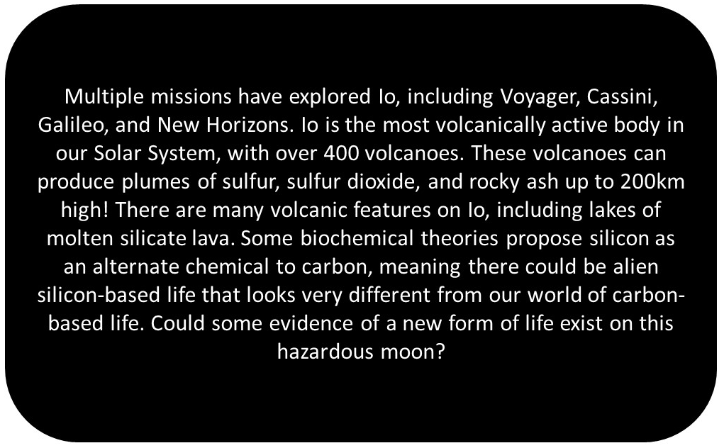
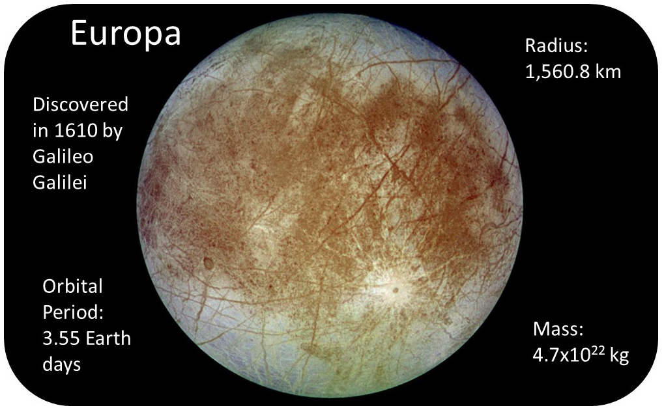
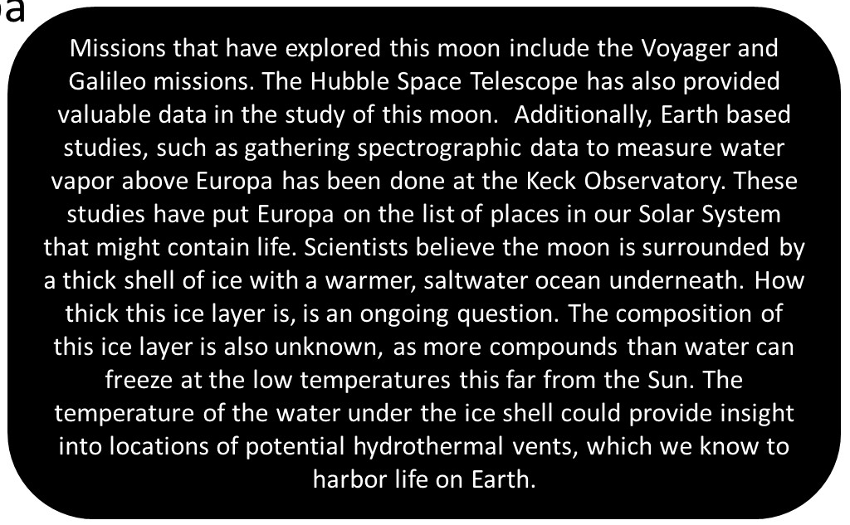

Slide 3
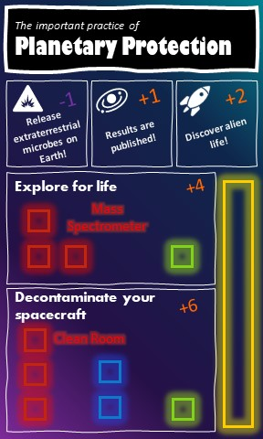
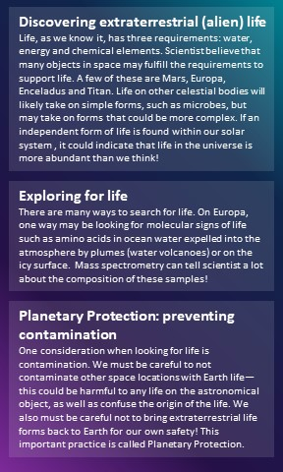
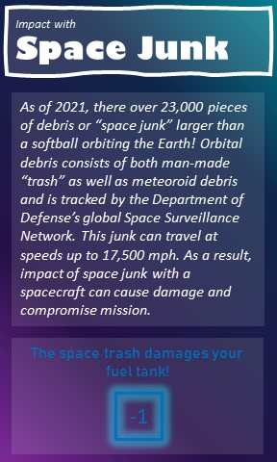


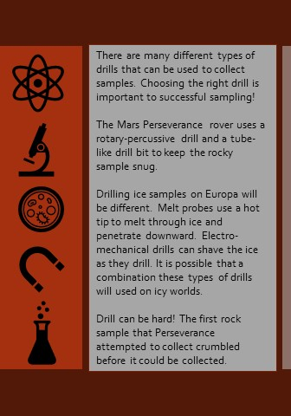
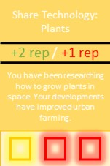
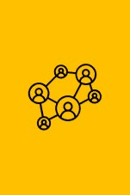
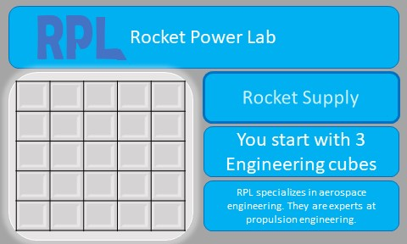

Slide 4
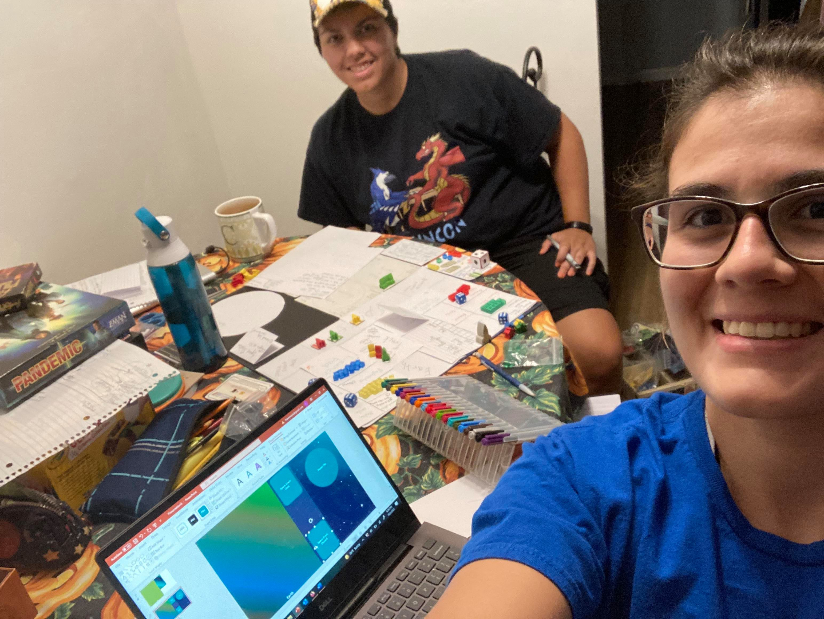
https://github.com/lkstanwyck/SpaceApps2021

Slide 5
Words
Hi! We’re Claudia and Lynn of the Penguins of Callisto. We chose to hack Space Quest: The Game. We’re here to prove that board games are a great format for teaching, while having fun.
Our game is called Otherworldly Explorers. The goal of the game is to increase public interest in space science by performing outreach and completing missions. We’re designing it to be easy to pick up and fairly quick to play. Players prepare for missions on Earth, then travel to the destination side of the board. Here we’ve demoed Jupiter and its 4 Galilean moons. All of our cards have details and fun facts sourced mostly from NASA datasets. We’ve included lots of information about past and future real-life missions, as well as space technologies.
We want people to have fun while learning amazing things about the world and universe around us. Check out our GitHub for more details!

